Slide 1



Configuring
Android Development Environment
Nilesh Singh

Slide 2
Requirements
JDK 6 (Java Development Kit ) and above
http://www.oracle.com/technetwork/java/javase/downloads/index.html
Eclipse + ADT
SDK
developer.android.com/sdk/index.html
  or
Note:Please refer README file from given DVD

Slide 3
Configuring
Android
Online

Slide 4
Configuring
Android
Offline

Slide 5
Creating
Android Virtual Device
(AVD)

Slide 6
Familiarization with
Eclipse IDE
Wednesday 5 December 2012

Slide 7
Important components of Eclipse for android
1) package Explorer
2) DDMS(Dalvik Debug Monitor Server )
3) LogCat
4) Console

Slide 8
Sample Application

Slide 9
Understanding
Android Project Structure
1) src folder: It contain .java file
2) bin folder: It contain .apk file
3) Assests folder: it contain text file, image file, video
file etc.
4) res folder: It has drawable and layout directory
which contain main.xml file
5) value folder: it contain string.xml file

Slide 10
Understanding
Android Project Structure...(2)
AndroidManifest.xml file
  R.Java and Resource
  Assets
  Widgets
Wednesday 5 December 2012

Slide 11
AndroidManifest.xml file
Every application must have an AndroidManifest.xml file.
The manifest presents essential information about the
application to the Android system.
The manifest does the following
1) It names the Java package for the application. The
package name serves as a unique identifier for the
application.
2) It describes the components of the application :
The activities, services, broadcast receivers, and
content providers.
Wednesday 5 December 2012

Slide 12
AndroidManifest.xml file...(2)
3) It determines which processes will host application
components.
4) It also declares the permissions that others are required
to have, in order to interact with the components of the
application
5) It declares the minimum level of the Android API,
that the application requires.
Wednesday 5 December 2012

Slide 13
R.Java
The file R.java is an auto-generated file,
that is added to your application,
by the Android plug-in.
This file contains pointers into
the drawable, layout, and
values directories.
You should never modify this file directly.
You will be only referencing R.java in most of your
applications.
Wednesday 5 December 2012

Slide 14
Auto-generated code in R.java
Wednesday 5 December 2012

Slide 15
package testPackage.HelloWorldText;
public final class R {
public static final class attr {}
  public static final class drawable
  {
    public static final int icon=0x7f020000;
  }
  public static final class layout
  {
    public static final int main=0x7f030000;
  }
  public static final class string
  {
    public static final int app_name=0x7f040000;
  }
}

Slide 16
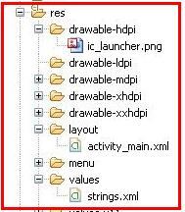
Resources
Almost all Android applications will have some sort of
resources in them; at a minimum they often have the
user interface layouts in the form of XML files.
Wednesday 5 December 2012

Slide 17
Resources
The three files that make up the default resources, are
created in the Resources folder:
  Ic_launcher.png - The default icon for the application
  Main.xml - The default user interface layout file for the application.
  Strings.xml – A string table to help with localization of the application
Wednesday 5 December 2012

Slide 18
Assets
Assets provide a way to include arbitrary files like
text, xml,fonts, music, and video, in your application.
If you try to include these files as 'resources',
Android will process them into its resource system,
and you will not be able to get the raw data.
If you want to access data untouched,
using Assets is one way to do it.
Wednesday 5 December 2012

Slide 19
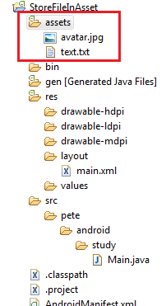
Android offers one more directory
where you can keep files which also will be included is package.
This directory called /assets.
The difference between /res and
/assets
is that, Android does not
generate IDs of assets content.
You need to specify relative path and
name, for files inside /assets.
Code to Access Assets :
InputStream is = getAssets().open("text.txt");
Wednesday 5 December 2012

Slide 20
Widgets
Android widgets can, bring lot of useful information directly to
your home screen, without the need to start the application.
Widgets should be viewed as mini applications
that sit on your home screen.
They display various bits of information from the main
application.
Wednesday 5 December 2012

Slide 21
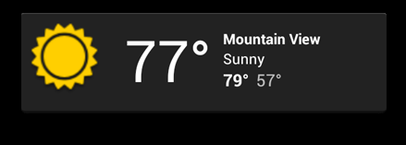
Widget types:
1)Information widgets
Information widgets typically
display a few crucial information
elements that are important to
a user and track how that information
changes over time.Good examples
for information widgets are
weather widgets, clock widgets
Weather widgets

Slide 22
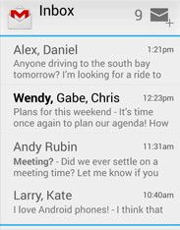
Widget types...(2)
2) Collection widgets
As the name implies, collection widgets
specialize on displaying multitude elements
of the same type, such as a collection of
pictures from a gallery app, a collection of
articles from a news app or a collection of
emails/messages from a communication
app.
ListView widget

Slide 23
Summery
1) Installation
2) Creating AVD
3) Familiarization with Eclipse IDE
4) Resources
5) AndroidMenifest.xml
6) Widgets

Slide 24
References
www.developer.android.com
www.developer.android.com/sdk/index.html

Slide 25

Wednesday 5 December 2012

